Slide 1
Shakin’ Hands and Living in SYN: A TCP Tale
CSE 461 Section

Slide 2
Joke Later!
Let’s learn things first!

Slide 3
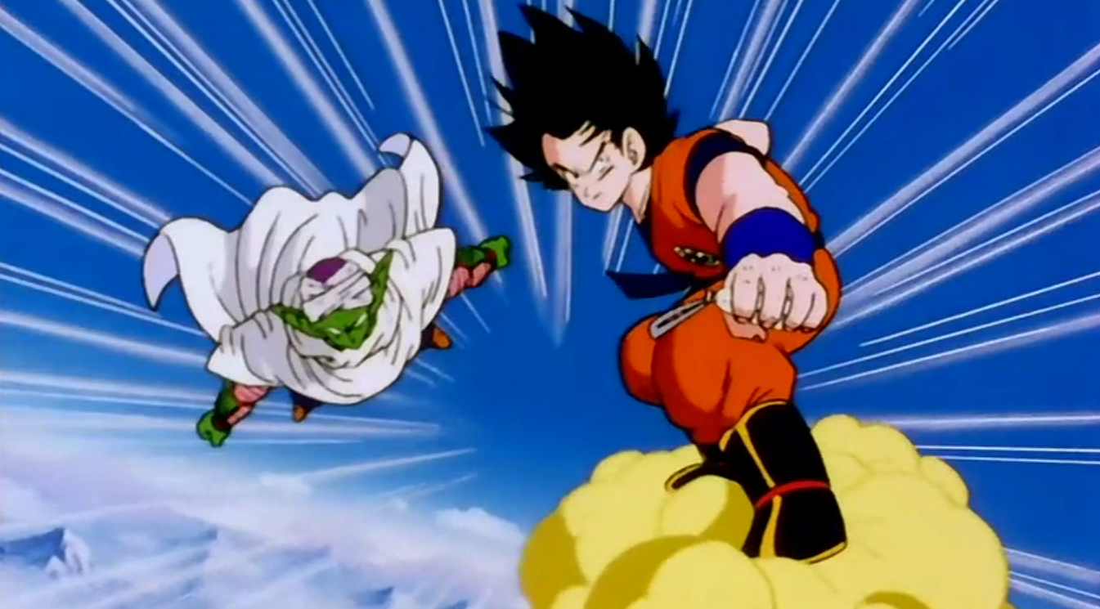
TCP Is Reliable
What do we mean by “reliable?”
We know when the other party receives or doesn’t receive certain data
Data arrives intact
Data arrives in the correct order (to the application layer, at least)

Slide 4
Where This Reliability Comes From
What’s the main mechanism for ensuring this reliability?
Sequence numbers!
They allow packets to be identified, acknowledged, and , implicitly re-requested
For TCP to work, clients must know each other’s sequence number schemes

Slide 5
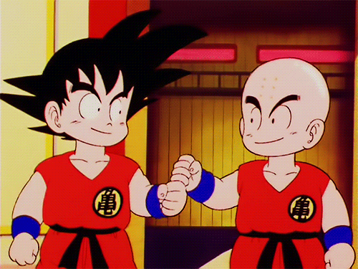
Starting Communication: The Three-Way Handshake
Need to synchronize with each other’s sequence numbers
How can we do this?
Active open vs. passive open
connect() vs. listen()
SYN packet
Send own sequence number A
SYN/ACK packet
Acknowledge with A+1, send own sequence number B
ACK packet
Acknowledge with B+1
Demonstration

Slide 6
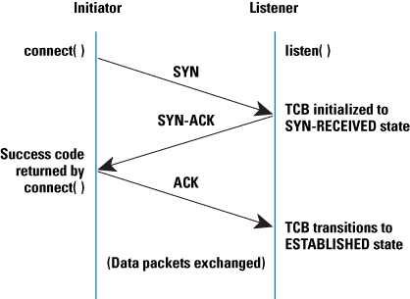
Three-Way Handshake Diagram

Slide 7
Ending Communications
We need a protocol for stopping communications
What could we do?
Let’s send packets to close the connection!
FIN/ACK sequence

Slide 8
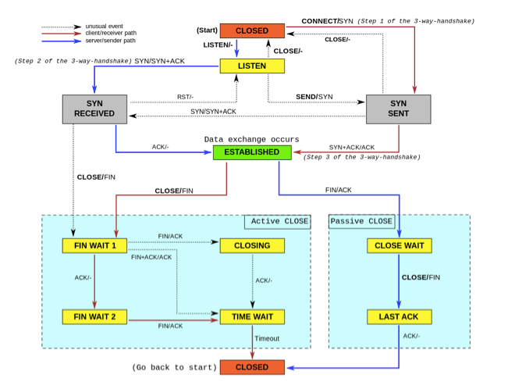
TCP FSA

Slide 9
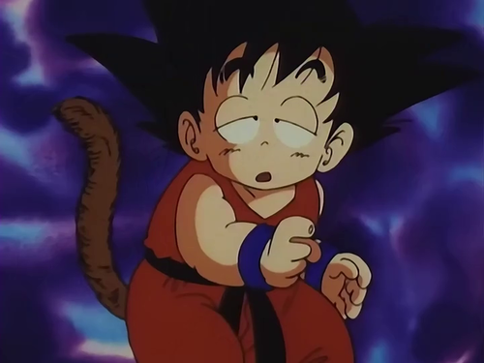
TCP Half-Open
TCP Half-Open
One client is in the open state; the other is not
How could this happen?
One endpoint has crashed
One endpoint has removed the socket
One endpoint has received a SYN and sent a SYN/ACK, but the other side has not ACKed the SYN/ACK yet
One endpoint has sent a FIN and received an ACK, but the other side has not sent a FIN yet
RST packet often sent in these cases

Slide 10
SYN Flooding
Hosts allocate a TCB (Transmission Control Block) on receipt of a SYN packet and put in the “SYN queue”
They then send a SYN/ACK and wait for an ACK response
However, what if one host sends lots of SYNs and no ACKs?
Causes the receiving host to allocate lots of TCBs, filling up resources
This attack is called “SYN flooding”

Slide 11
SYN Flooding Countermeasures
What ideas can we think of to make it so that SYN flooding doesn’t work?
Constraint: we don’t want to break TCP!)
Identify SYN flooders and filter their packets
Reduce our timeout until we garbage-collect TCBs
Recycle half-open TCP connections
Use SYN cookies
Sequence number encodes all of the data that would otherwise be stored
This allows us to garbage-collect our SYN queue and still respond to subsequent ACKs

Slide 12
TCP Connection Hijacking
TCP is not (by default) encrypted
This means anyone sniffing our packets can see the sequence numbers being used
How is this a problem?
For many protocols, the sequence and acknowledgement numbers are the other “security”
Using these numbers can make a host think that you’re sending the next packet in a communication session
This can cause the communication to be re-addressed to a new IP address/port

Slide 13
TCP Veto
In TCP, how does a server know to discard a duplicate packet? What does it check for?
Correct checksum
Same sequence number
How are sequence numbers generated?
Randomly at first, then incremented
Often, this increment is unpredictable, and depends on received data length
How could we secret inject a packet into communication?
Predict the length and sequence number of some data in the future
Pre-empt that data with a similar packet

Slide 14
Joke Time
Two jokes

Slide 15
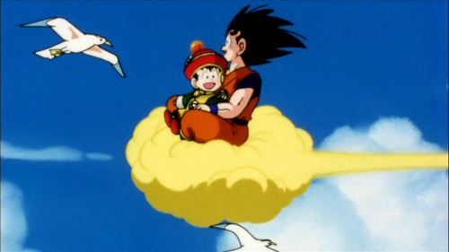
Questions?

